Slide 1
DATA STRUCTURES & ALGORITHMS
-By Sudhakar

Slide 2
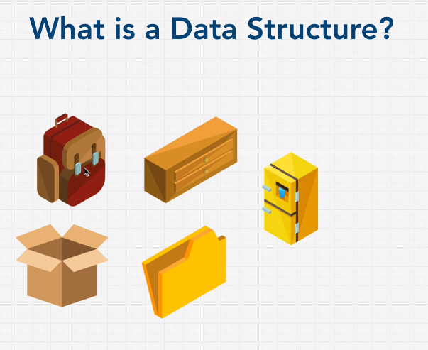

Slide 3
Contents
Introduction to Data Structures
Big O
Built-in Data Structures
Custom Data Structures
Algorithms
Sorting
Searching

Slide 4
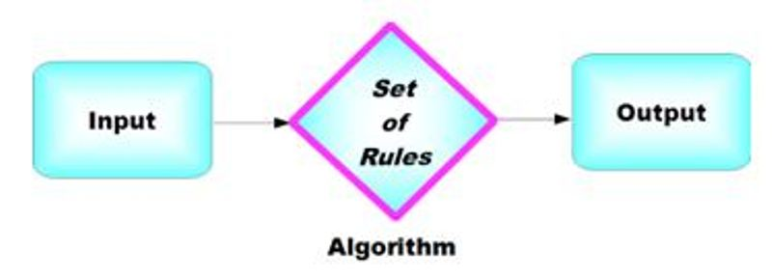
What is Data Structures & Algorithm?
Data structures are the building blocks of any program or the software.
Data structure is a way of store and organize data so that it can be used efficiently.
Data structure will help us to write Memory & Time efficient Code.
An Algorithm is a finite set of instructions which are being carried in a specific order to perform the specific task
To solve a problem we must write a algorithm which will take a input and provide the required output.
Data Structure + Algorithms = Programs.

Slide 5
Need of Data Structures
As applications are getting complexed and amount of data is increasing day by day, there may arise the following problems:
Processor speed: To handle very large amount of data, high speed processing is required, but as the data is growing day by day to the billions of files per entity, processor may fail to deal with that much amount of data.
Data Search: Consider an inventory size of 106 items in a store, If our application needs to search for a particular item, it needs to traverse 106 items every time, results in slowing down the search process.
Multiple requests: If thousands of users are searching the data simultaneously on a web server, then there are the chances that a very large server can be failed during that process
in order to solve the above problems, data structures are used.

Slide 6
BIG ‘O’
Big O Notation is a way of to measure an Algorithms efficiency.
Represents worst case complexity of an algorithm
There are two types to measure Algorithms efficiency,
Time Complexity
It is a measure of how long the function takes to run the function.
Space Complexity
The amount of memory used by the function. BIG O Time complexity
O(1): Constant time O(n): Linear time.
O(n²): Quadratic. O(log n): Logarithmic.
O(n log n): Linearithmic. O(2^n): Exponential run time.
6

Slide 7
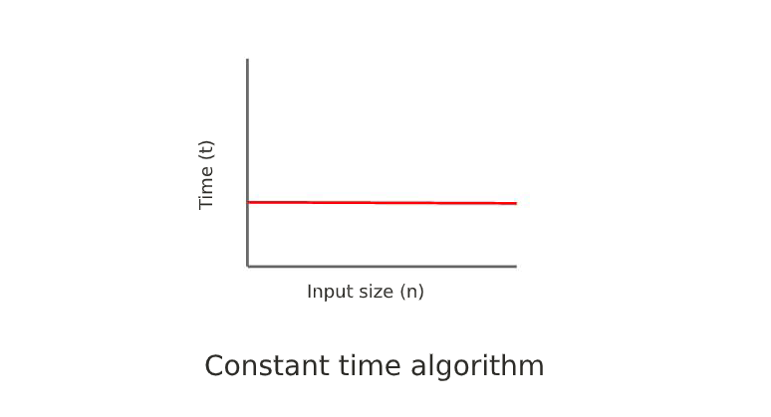
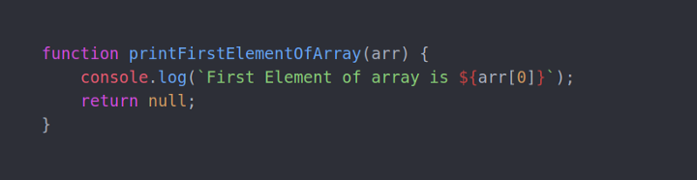
Constant time O(1).
An algorithm is said to run in constant time, It means that as you increase the size of the input to the function. The execution time remains the same.
Run time is independent of the input size of the problem.

Slide 8
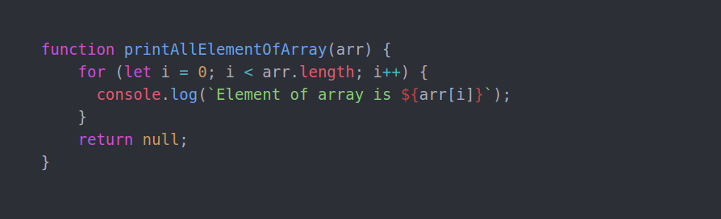
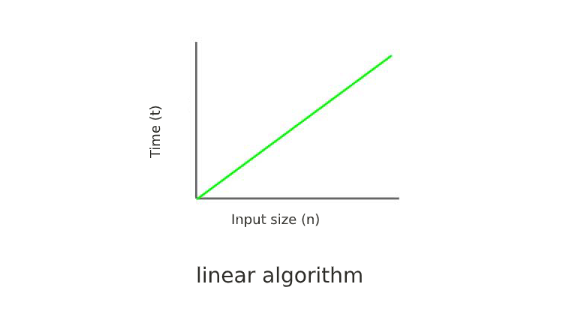
Linear time O(n).
The problem requires a small amount of processing time for each element in the input.
The execution time of the function is directly proportional to the input size. the run time of the function grows as the input grows.
O(n) means that the growth rate is linear — as n increases, the processing time increases at the same rate.

Slide 9
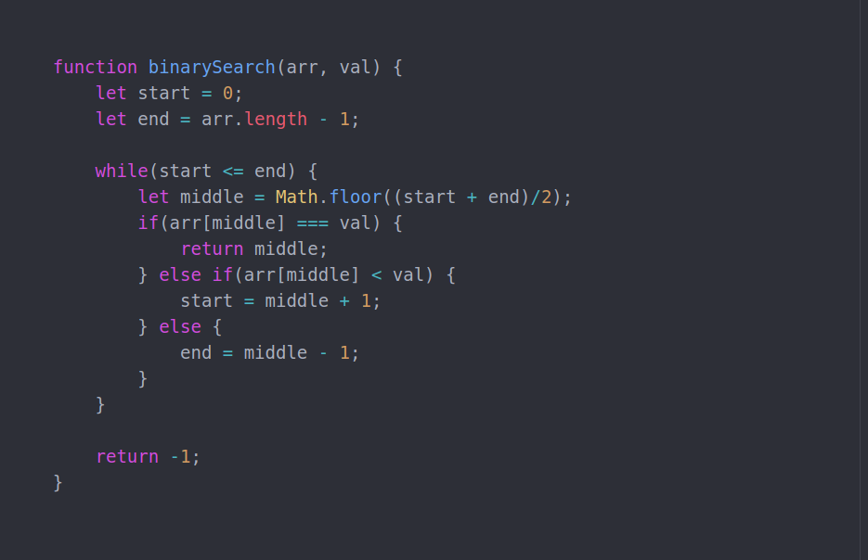
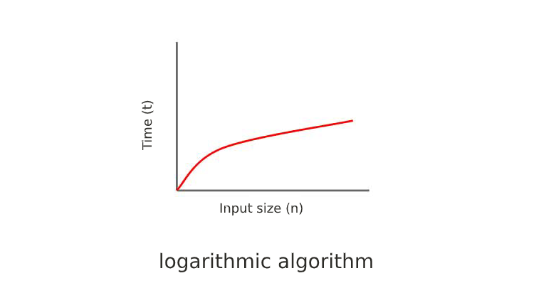
Logarithmic time O(log n).
When a big problem is solved by transforming it into a smaller size by some constant fraction.
Execution time is proportional to the logarithm of the input size.
Input size is reduces by half every iteration.
Once a list is ordered, it can be searched using a divide -and-conquer strategy.

Slide 10
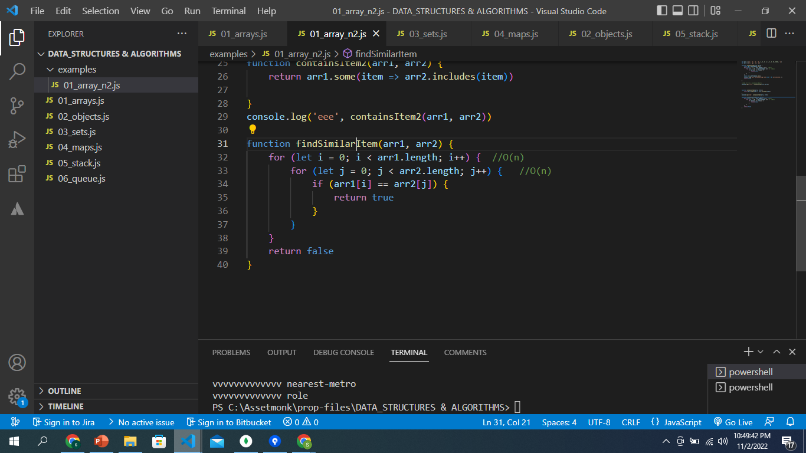
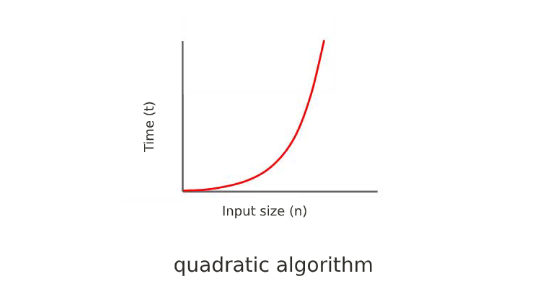
Quadratic time O(n^2)
The problem process all the pairs of the element.
The quadratic algorithm is almost the reverse of the logarithmic algorithm. The number of steps required by the quadratic algorithms is the square root of input size. If the input size is 2, then the required steps are 4. If the input is size 8, it will take 64, and so on. and we mark it as O(n²).

Slide 11
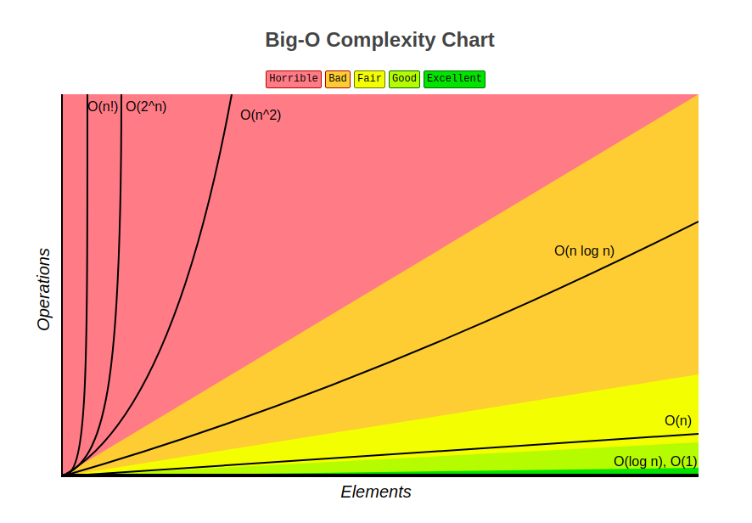

Slide 12
Types of Data Structures
Built-In Data Structures
Array
Object
Map
Set
Custom Data Structures
Stack
Queue
Linked list
Hash Table

Slide 13
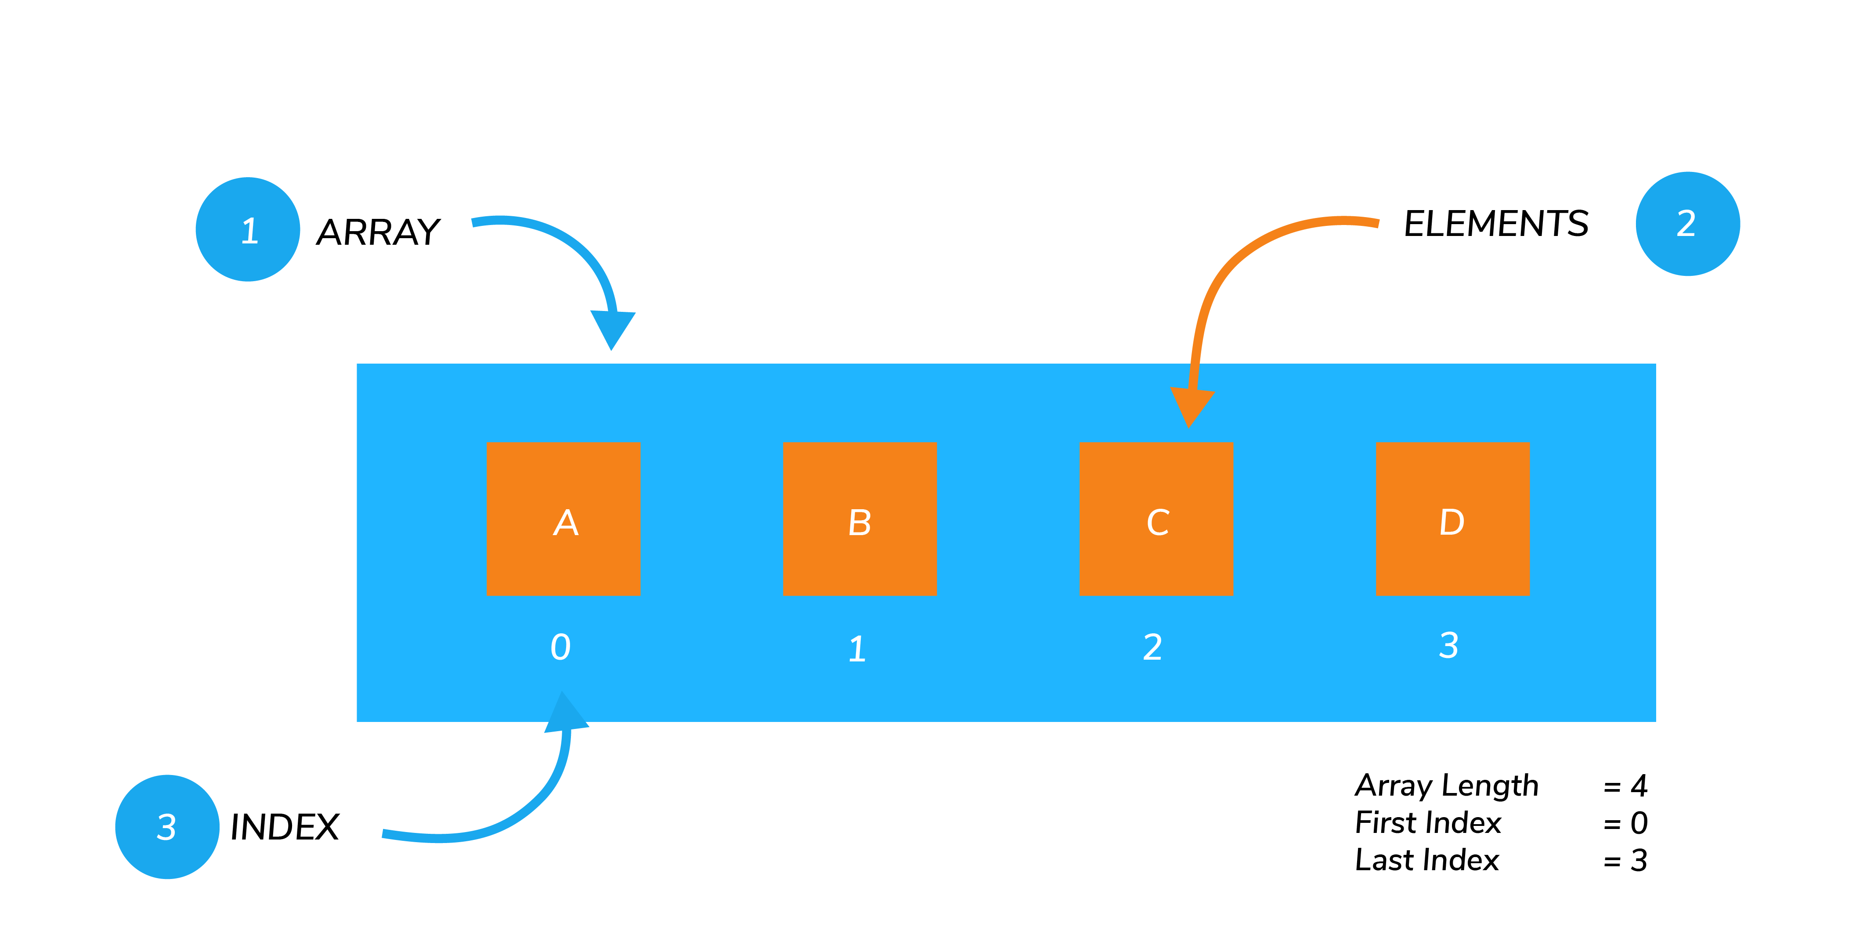
Array
An Arrays is a data structure that hold a collection of values.
An Arrays can contain mix of different data types, we can store strings, Booleans, numbers, objects.
Arrays are zero-indexed & insertion order is maintained.
BIG O time complexity. Insert/remove from at end: O(1)
Insert/remove from at beginning : O(n)
Access: O(1)
Search: O(n)
forEach/map/filter/reduce: O(n)

Slide 14
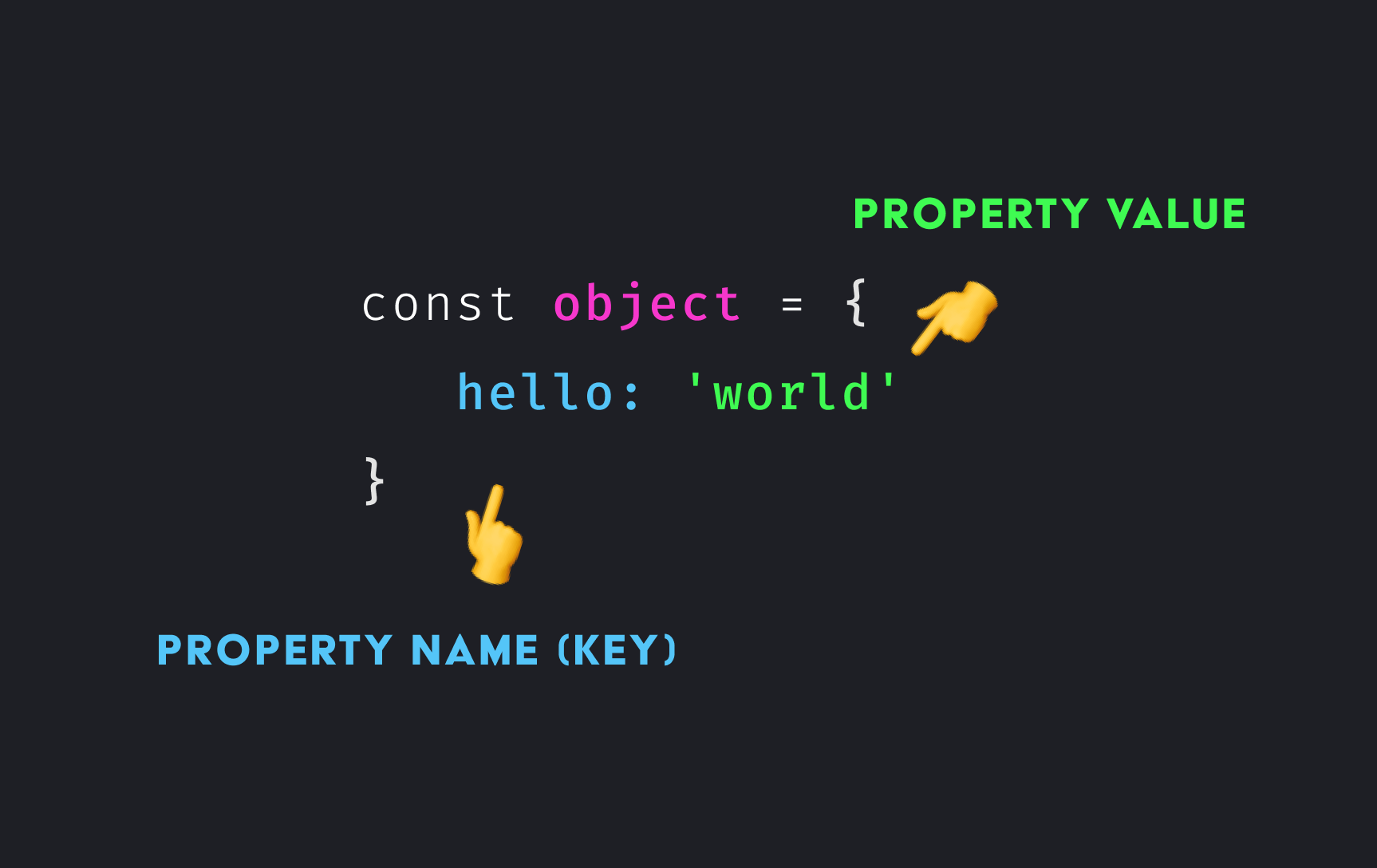
Object
An Object is an unordered key-value pairs.
Objects is not iterable with for of loop.
BIG O time complexity.
Insert: O(1)
Remove: O(1)
Access: O(1)
Search: O(n)
Object.keys(): O(n)
Object.values(): O(n)
Object.entries(): O(n)

Slide 15
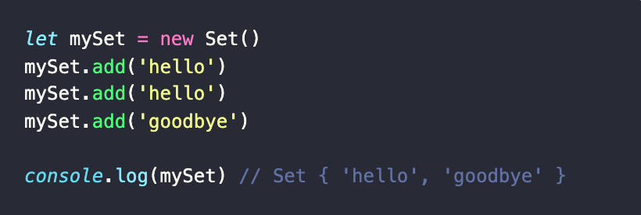
Set
A Set is a data structure that can hold a collection of values. The values however must be unique.
An Set can contain mix of different data types, we can store strings, Booleans, numbers, objects.
Sets do not maintain an insertion order.

Slide 16
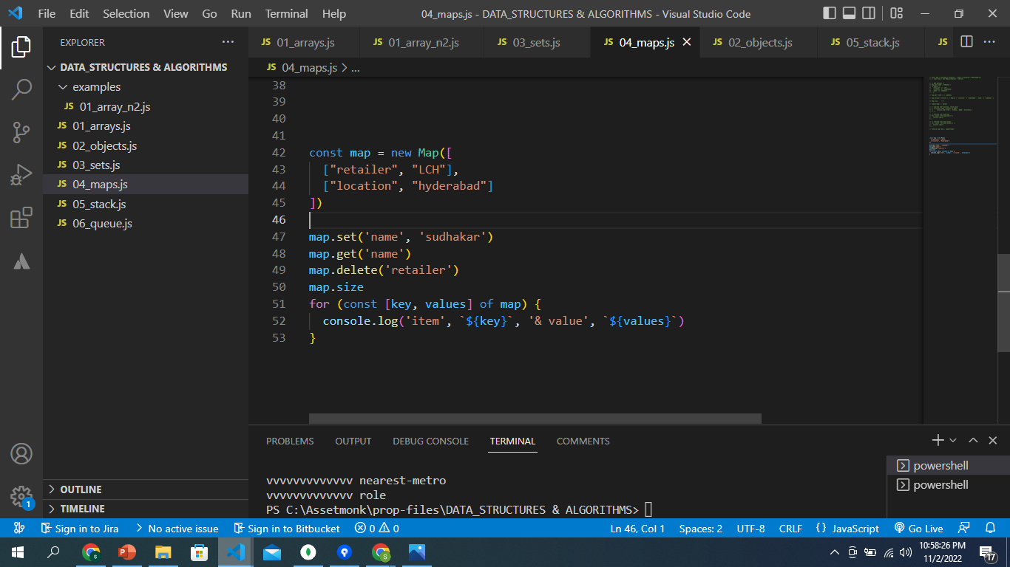
Map
A map is an ordered collection of key-value pairs.
Both keys & values can be any data type.

Slide 17
Differences
Set v/s Array
Arrays can contain duplicate values, whereas Set cannot.
Insertion order is maintained in Arrays, but not in Sets.
Searching & Deleting an element in the Set is faster compared to Array.
Map v/s Object
A object is an unordered & map is ordered collection of key-value pairs.
Keys in objects can only be string or symbol type whereas is maps, they can be any data type.
Objects are not iterable, whereas maps are iterable with for of loop.
Map provides better performance when frequent additions and removals of key-value.

Slide 18
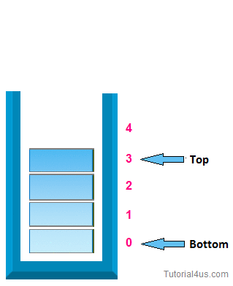
Stack
A stack is a sequential collection of elements.
It follows the principle of Last In First Out (LIFO).
Last element inserted into the stack is first element to be removed.
Usage-
Browser history tracking,
undo operation when typing,
Call stack in JS runtime.
Stack methods
Push(): Add an element to the stack.
Pop(): Remove an element from the stack.
Peek(): Get the topmost element of the stack.
isEmpty(): Checks if the stack is empty.
size(): get number of elements in the stack.

Slide 19

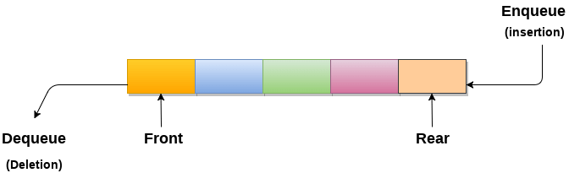
Queue
A Queue data structure is a sequential collection of elements.
It follows the principle of First In First Out (FIFO).
The first element inserted into the queue is first element to be removed.
Usage
Printers
Booking a tickets.
Callback queue in JS runtime.
Queue Methods
Enqueue: Adds an element to the end/rear of the queue.
Dequeue : Removes an element from the start or front of the queue.
Peek(): Get the value of the element at the front of the queue.
isEmpty(): Checks if the queue is empty.
size(): get number of elements in the queue.

Slide 20
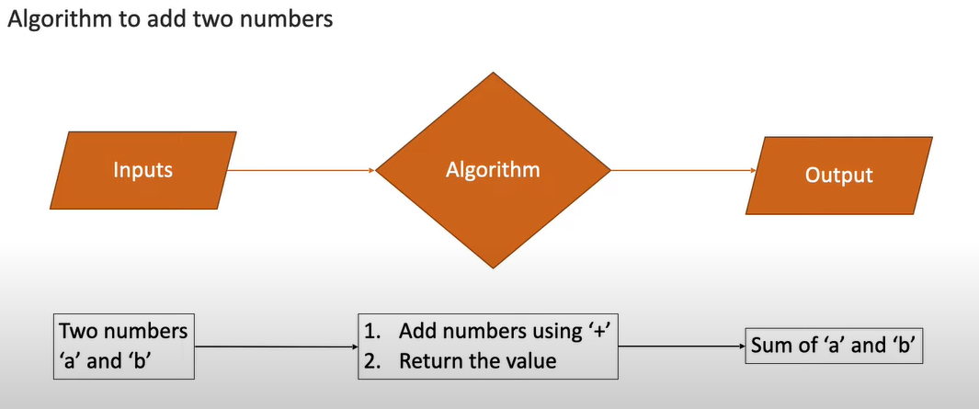
ALGORITHM
A finite set of step-wise instructions that should be followed to perform a specific task like solving a logical or a mathematical problem.
it is just a solution (logic) of a problem, which can be represented either as an informal description using a Flowchart or Pseudocode.

Slide 21
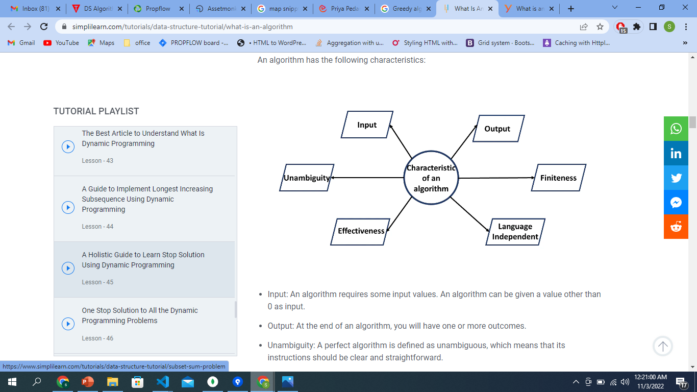
Characteristics of an Algorithm
Input- An algorithm has some input values. We can pass 0 or some input value to an algorithm.
Unambiguity :- the instructions should be clear, simple & straightforward..
Finiteness:- algorithm should contain a limited number of instructions, i.e., the instructions should be countable.
Effectiveness:- An algorithm should be effective as each instruction in an algorithm affects the overall process.
Output: We will get 1 or more output at the end of an algorithm.

Slide 22
Types of Algorithm
Search Algorithm
Linear Search
Binary Search
Sort Algorithm
Bubble sort
Insertion sort
Selection sort
Merge sort
Quick sort

Slide 23
What is Good Code?
Readable
Writing & Presenting your code in such a manner that it can be easily read & understood.
Code clearly communicates it’s intent to the reader.
Reusable
Reusable code is necessary and highly valuable for any software product. It helps to keep your code base simple and reduces repetition. In the long run, reusable code can save time and will be more cost-effective.
Scalable
If a new requirements come to you, in how much of a change, you can adopt to that requirement, the lesser the lines required, the more scalable the code is. (Speed & Memory)

Slide 24
Conclusion
Data structures allow us to organize and store data.
Algorithms allow us to process that data in a meaningful way.
Understanding DSA leads to write a code that is more efficient and more reliable.
Data structures are reusable, i.e. once we have implemented a particular data structure, we can use it at any other place.
Usage of proper data structure, can help programmer save lots of time or processing time while operations such as storage, retrieval or processing of data.
Efficiency of a program depends upon the choice of data structures.

Slide 25
Thank You

